Slide 1
Professionals as Researchers in the Further Education & Skills Sector
Notes:
Briefly introduce
What’s in it for me?

Slide 2
Aims of the Professionals as Researchers programme:
To enhance current practice in the FE sector by engaging in research-based projects
To outline the significance of teacher-led change using an action research approach
To signify the influence of research-based projects as professional development and the impact this has on FE teachers’ learners
Education and Training Research tool - https://set.et-foundation.co.uk/digital-assets/qtlsmap/

Slide 3
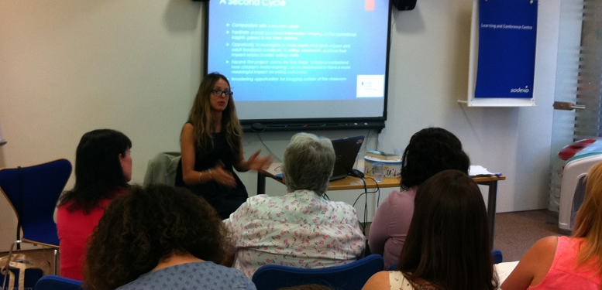
Research-based projects as professional development - the impact on learners and organisations
Teachers’ participation in conferences
Teachers’ publications in professional journals
Teachers’ reports as part of institutional strategies

Slide 4
Professional development and Impact
Using Woodcock’s idea of conceptual vocabulary I focused on writing as opposed to discussion as a source of evidence when evaluating student understanding and progress. My project concluded that different students understood and used language differently: ‘A concept, the meaning of the word associated with it, and the understanding of the specifics to which it relates, are fluid’
Teacher’s report and Field notes
Learning and
Attainment
‘A rewarding experience that has had a significant impact on my teaching’ Evaluation Survey ‘Transformed teaching practice and methods, allowed reflection’ Final report
Professional Development
Schools’
needs and targets
‘Research has had a tremendous impact on classroom practice in all the schools’ Headteacher
Students felt it really helped them make progress.
‘It seems to be one of the most effective ways to plug a gap or address a need’ Evaluation Survey
‘The project exceeded my expectations because it actually led me on to further Doctorate study’
Teacher’s Evaluation Surveys – comments
I am passionate about digital technology (when used as part of a Blended Classroom)
especially when this can cut teacher workload and maximise the student experience
Teachers’ aspirations

Slide 5
Research-engaged colleges/schools
According to BERA (2018) the most effective forms of CPD involve:
• the use of specialist advisors and external experts
• collaborative enquiry and structured peer support
• the opportunity to explore why things do and don’t ‘work’
• the exploration and challenging of teachers own beliefs and assumptions
Research-based projects are about ‘doing with’ not ‘being done to’!
References:
_________________________________________________________________________________________________________________________________________________
BERA (2014) Research and the Teaching Profession. British Educational Research Association. Available at: http://www.bera.ac.uk/wp-content/uploads/2013/12/BERA-RSA-Research-Teaching-Profession-FULL-REPORT-for-web.pdf\

Slide 6
Professionals as Researchers CPD
In the last 6 years the University of Greenwich has been offering opportunities for schools and more recently colleges to build teacher-led systematic research into everyday practice with the collaboration of the University of Greenwich.
Our team will work alongside teachers on dynamic action research projects designed to investigate and enrich teaching and learning in ways which will have long- term, sustainable outcomes.

Slide 7
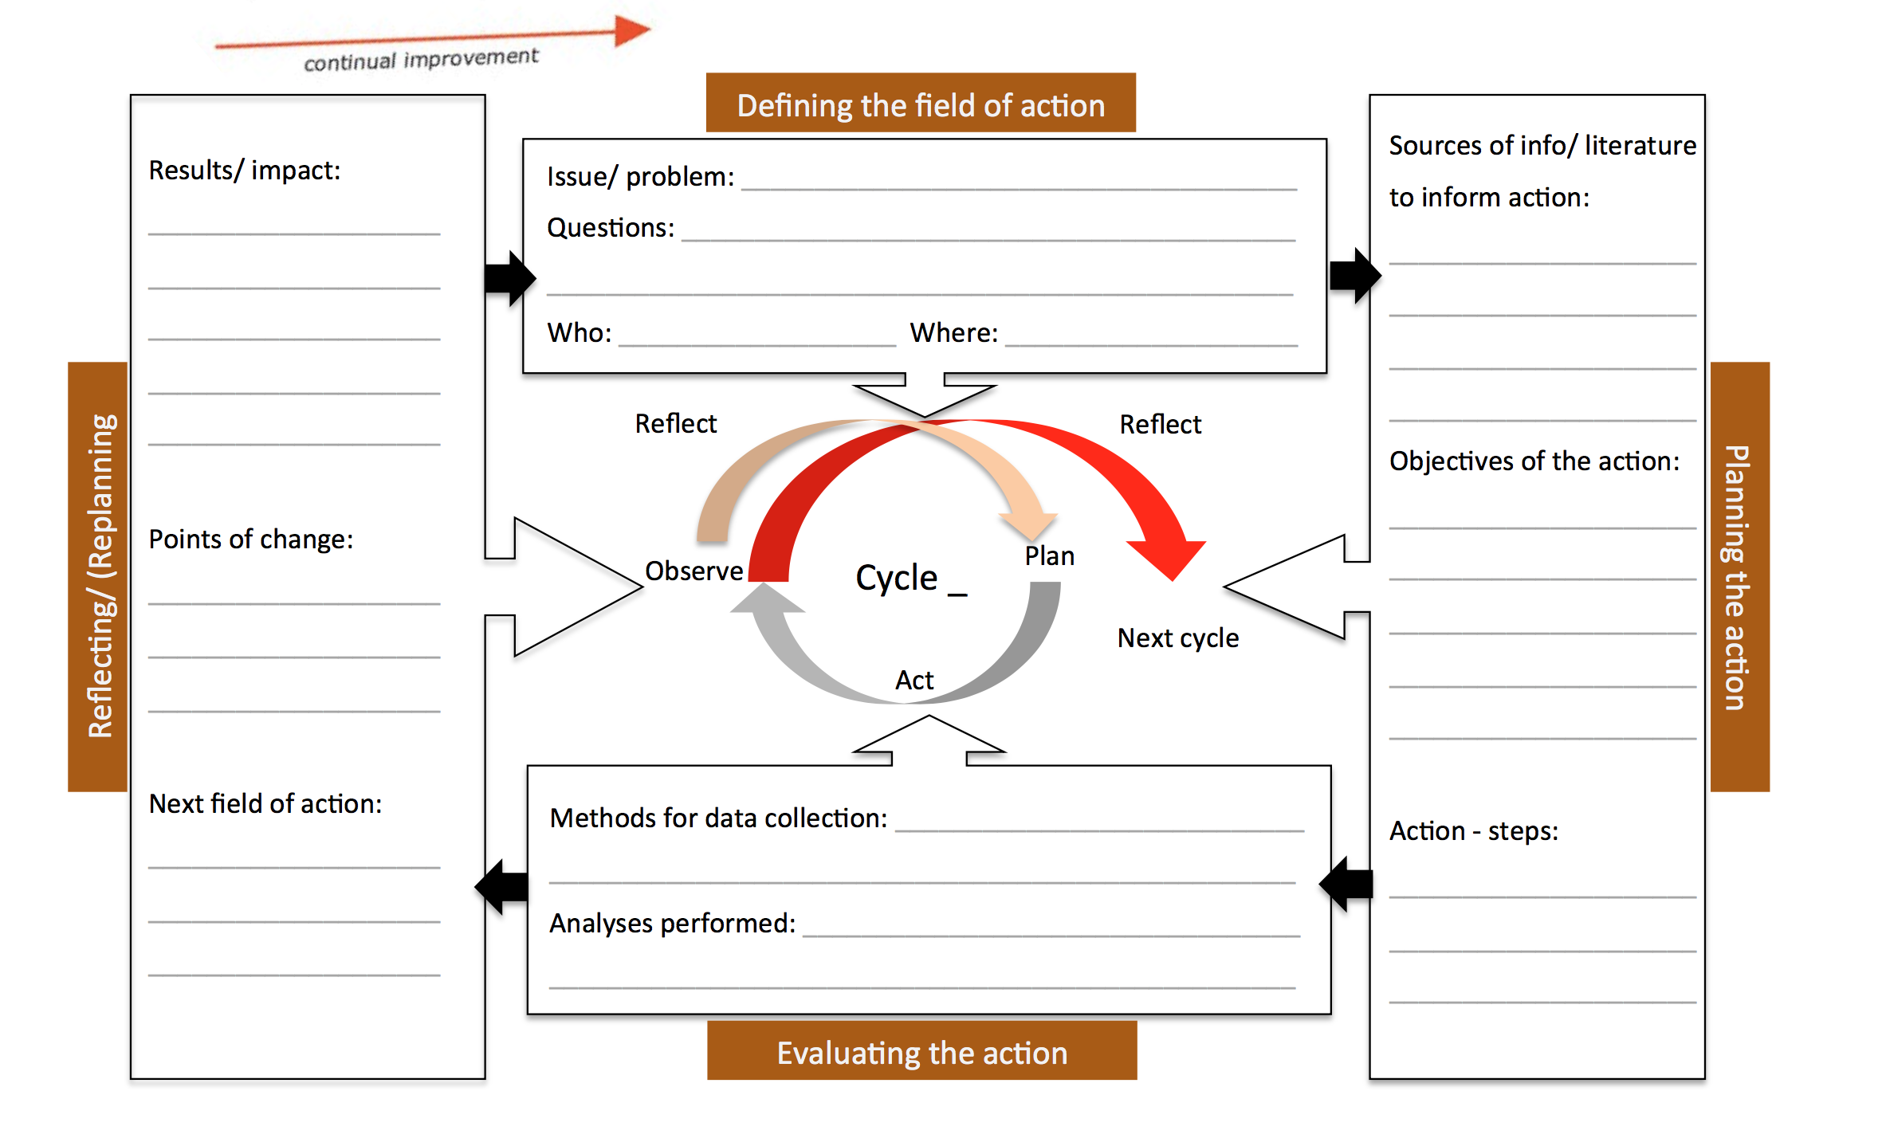
Action research cycle
Action research approach
Stage 1 action
Stage 2 action

Slide 8
Identifying an area of professional concern or interest
Identifying professional/ educational values

Slide 9
Presentation of findings (non- credit)
Teachers will design a PowerPoint for upload onto the Professional as Researchers’ site
Headings include:
Context
Research inspiration and rationale
Professional tensions
Aims
Actions
Outline
Data collection
Analysis of data
Impact
Reflections

